Slide 1
The Basics of Multiple Myeloma
This program is supported by educational grants from Celgene Corporation, Millennium: , and Onyx Pharmaceuticals.

Slide 2
About These Slides
Users are encouraged to use these slides in their own noncommercial presentations, but we ask that content
and attribution not be changed. Users are asked to honor this intent
These slides may not be published or posted online
without permission from Clinical Care Options
(email permissions@clinicaloptions.com)
Disclaimer
The materials published on the Clinical Care Options Web site reflect the views of the authors of the
CCO material, not those of Clinical Care Options, LLC, the CME providers, or the companies providing educational grants. The materials may discuss uses and dosages for therapeutic products that have not been approved by the United States Food and Drug Administration. A qualified healthcare professional should be consulted before using any therapeutic product discussed. Readers should verify all information and data before treating patients or using any therapies described in these materials.

Slide 3
Faculty
Patricia Mangan, APRN, BC
Nurse Lead
Hematologic Malignancies/Bone Marrow and
Stem Cell Transplant
Abramson Cancer Center
University of Pennsylvania
Philadelphia, Pennsylvania
Notes:
This slide lists the faculty who were involved in the production of these slides.

Slide 4
Disclosures
Patricia Mangan, APRN, BC, has disclosed that she has received consulting fees from Celgene, Millennium, and Sanofi Aventis, and fees for non-CME/CE services from Celgene, Millennium, and Onyx.
Notes:
This slide lists the disclosure information of the faculty and staff involved in the development of these slides.

Slide 5
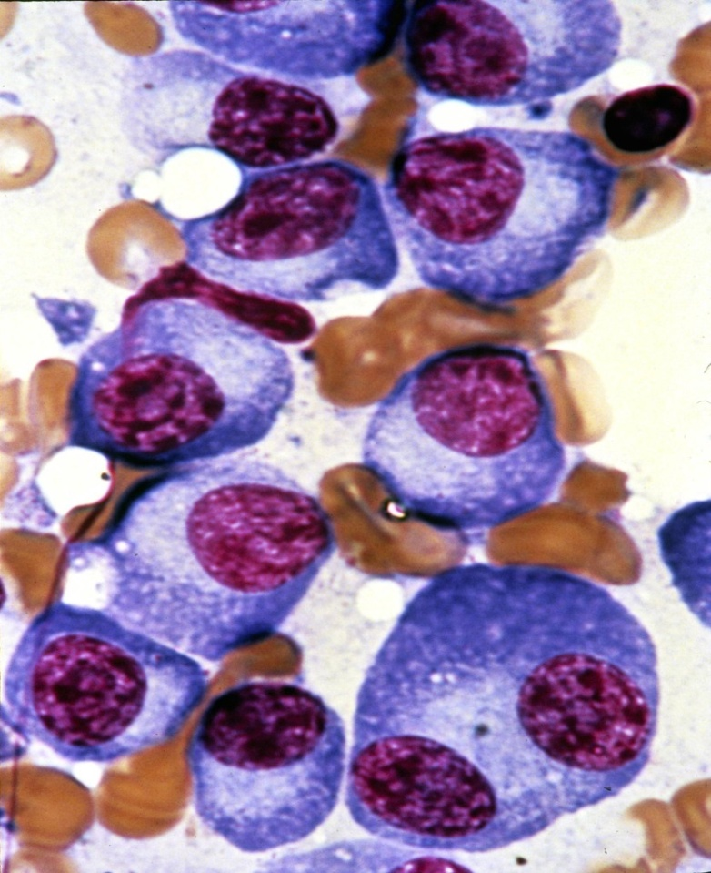
What Is Multiple Myeloma?
Cancer of the plasma cells
in bone marrow
Growth of myeloma cells:
  Disrupts normal bone marrow function
  Reduces normal immune function
  Results in abnormal production and release of monoclonal protein into blood and/or urine
  Destroys and invades surrounding bone
Barlogie B, et al. In: Williams Hematology; 2006. Durie BG. IMF 2007.

Slide 6
Multiple Myeloma Epidemiology
New Cases, n (US, 2014) | Deaths, n (US, 2014) | Mean Age at Diagnosis, Yrs | 5-Yr Relative Survival Rates 2004-2010, %
24,050 | 11,090 | 62 | 44.9
Death rates
  Decreased during 1991-2005
  11.3% decrease for women,
  7.25% decrease for men
Risk factors
  Unknown in the majority of cases
  Increased with age, male sex, obesity, and black race
Variable response to treatment and variation in survival
  From a few mos to > 10 yrs
  High-risk attributes are thought to play a primary role
  20% of patients survive
  > 10 yrs, regardless of therapy
  Novel agents may neutralize the effects of some high-risk features
Badros AZ. J Natl Compr Canc Netw. 2010;8:S28-S34. Kurtin S. Oncology Nurse Ed. 2011;25. Siegel R, et al. CA Cancer J Clin. 2014;64:9-29. SEER Stat Fact Sheets: Myeloma.

Slide 7
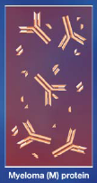
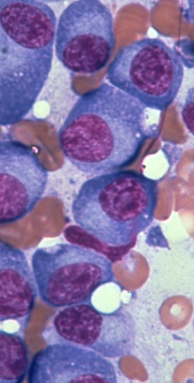
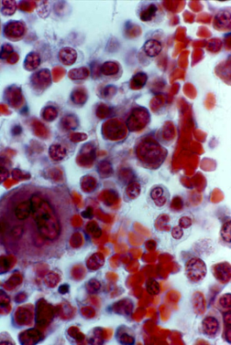
Myeloma Can Result in a Broad Spectrum of Clinical Manifestations
Renal compromise (30%)
M-protein
Neuropathy (33%)
Hyperviscosity
Amyloidosis
Immune
deficiency
Infection (15%)
Multiple myeloma cells
Hypercalcemia
(15% to 20%)
Destruction of bone
Bone pain
Lytic lesions (70%)
Marrow infiltration
Hoffman R. Hematology: basic principles and practice, 5th edition; 2008. Ropper AH, et al. N Engl J Med. 1998;338:1601-1607.
Anemia (10% to 35%)

Slide 8
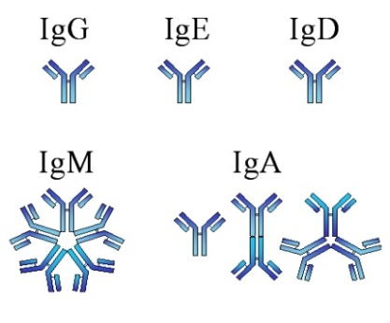
Classification of Myeloma
Heavy chain:
IgG, IgA, IgD, IgM, IgE
77% of myeloma cases
IgG and IgA most common
Nonsecretory:
No detectable immunoglobulin
1% to 2% of myeloma cases
Light chain (Bence-Jones protein):
Kappa (κ) or lambda (λ)
20% of myeloma cases
Variable region
Light chain
Heavy chain
Constant region
Kumar SK, et al. Mayo Clinic Proc. 2009;84:1095-1110.
Schmidt-Hieber M, et al. Haematologica. 2013;98:279-287.
Serum free light chain

Slide 9
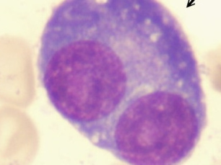
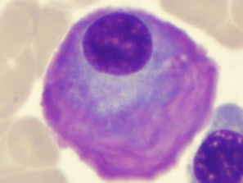

Disease Trajectory
Nonmalignant
Accumulation
Malignant Transformation
Aggressive and Stromal Independent
Stroma
angiogenesis
and IL-6
dependent
Plasma cell leukemia
MGUS
Smoldering Myeloma
Multiple Myeloma
< 3 g M-protein
< 10% clonal BMPC
No MM-related
end-organ damage
1%/yr risk of progression to MM
≥ 30 g/L M-protein
≥ 10% clonal BMPC
No MM-related
end-organ damage
10%/yr risk of progression to MM in the first 5 yrs
≥ 10% clonal BMPC
M-protein in serum and/or urine
≥ 1 CRAB features of disease related
to organ damage
C: Calcium elevation > 11.5 mg/L or ULN
R: Renal dysfunction (serum creatinine
> 2 mg/dL)
A: Anemia (Hb < 10 g/dL or 2 g < normal)
B: Bone disease (lytic lesions or osteoporosis)
Kuehl WM, et al. Nat Rev Cancer. 2002;2:175-187. Vacca A, et al. Leukemia. 2006;20:193-199. Agarwal A, et al. Clin Cancer Res. 2013;19:985-994. Durie BG, et al. Hematol J. 2003;4:379-398. Kurtin SE. JAdPrO, 2010;1:19-29.
Notes:
BMPC, bone marrow plasma cells; Hb, hemoglobin; MGUS, monoclonal gammopathy of unknown significance; MM, multiple myeloma; IL-6, interleukin-6; ULN, upper limit of normal

Slide 10
Role of Bone Marrow Microenvironment in Myeloma
Myeloma cells
IL-6
TNFα
IL-1β
Bone marrow stromal cells
ICAM-1
Bone marrow vessels
VEGF
bFGF
IL-2
IFN γ
PBMC
CD8+ T cells
NK cells
Hideshima T, et al. Blood. 2000;96:2943-2950.
Davies FE, et al. Blood. 2001;98:210-216.
Gupta D, et al. Leukemia. 2001;15:1950-1961.
Mitsiades N, et al. Blood. 2002;99:4525-4530.
Lentzsch S, et al. Cancer Res. 2002;62:2300-2305.

Slide 11
Diagnostic Evaluation
Establish diagnosis of MM
  MGUS
  Smoldering
  Active
Determine subtype
  Heavy chain/light chain
  Nonsecretory
  Solitary plasmacytoma
Determine stage
  International Staging System
  Durie-Salmon staging system
Estimate prognosis
  Cytogenetics
  Albumin
  β₂-microglobulin
  Ploidy
Identify need for immediate intervention
  Severe hypercalcemia
  Acute renal failure
  Cord compression
  Severe pain or
  impending fracture
History and physical
CBC, differential and platelet count
Additional laboratory tests Serum immunoglobulins Quantitative (IgG, IgM, IgA, IgD) SPEP Serum free light chain assay (kappa, lambda) BUN, creatinine, electrolytes Serum calcium (corrected) Serum albumin β₂-microglobulin LDH Additional testing based on preliminary analysis 24-hr urine | Bone marrow biopsy and aspiration Hematopathology Presence of plasma cells, % Cellularity Ploidy Cytogenetics FISH Gene expression profiling
Radiology Skeletal survey MRI if vertebral compression fractures suspected PET/CT
NCCN. Clinical practice guidelines in oncology: multiple myeloma. v.2.2014. Kurtin S. JAdPrO. 2010;1:19-29.
Notes:
BUN, blood urine nitrogen; CBC, cell blood count; CT, computed tomography; FISH, fluorescence in situ hybridization; LDH, lactate dehydrogenase; MGUS, monoclonal gammopathy of undetermined significance; MRI, magnetic resonance imaging; PET, positron emission tomography; SPEP, serum protein electrophoresis.

Slide 12
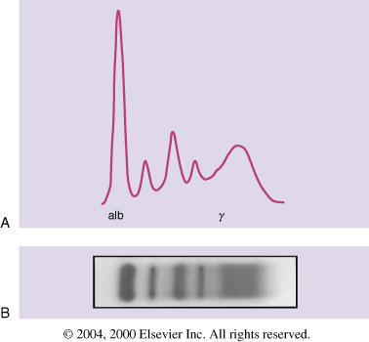
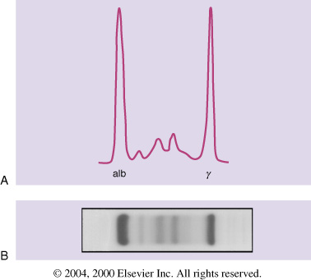
Monoclonal Protein—M Spike
Normal SPEP
Abnormal SPEP
Amount/type of M-protein varies among patients (IgG, IgA 80% of cases)
Abnormal M-protein (immunoglobulin) loses immune function and adheres and binds to tissues
Barlogie B, et al. In: Williams Hematology; 2006. p. 1501.
Durie. IMF 2007. MMRF. Intro to Myeloma. 2005.

Slide 13
International Staging System
Stage | Criteria | Median OS, Mos
I | Serum β₂m < 3.5 mg/L Serum albumin ≥ 3.5 g/dL | 62
II | Serum β₂m < 3.5 mg/L Serum albumin < 3.5 g/dL OR Serum β₂m 3.5 through < 5.5 mg/L | 44
III | Serum β₂m ≥ 5.5 mg/L | 29
Serum β₂m reflects tumor load and is elevated in renal failure
Greipp PR, et al. J Clin Oncol. 2005;23:3412-3420.
Dimopoulos M, et al. Leukemia. 2009;23:1545-1556.
Notes:
β₂m, β₂-microglobulin; OS, overall survival.

Slide 14
Cytogenetic Testing Methodologies
Methodology | Advantages | Disadvantages
Karyotype analysis | Highly sensitive for the detection of chromosomal abnormalities in dividing cells | Low yield of karyotype abnormalities from MM bone marrow samples Does not detect some aberrations Cannot describe possible heterogeneity within a population of clonal cells
FISH | Can be performed in non dividing cells Can detect translocations Validation with positive and negative controls is standard | Variable scoring criteria Some aberrations technically difficult to detect
GEP | May be helpful with prognosis May lead to development of more targeted therapies | Not performed locally Expensive Unclear what should be done with the information
Notes:
FISH, fluorescence in situ hybridization; GEP, gene expression profiling; MM, multiple myeloma.

Slide 15
Cytogenetic Classification
mSMART 2.0: classification of active myeloma
High Risk 20%
Intermediate Risk 20%
Standard Risk 60%
FISH
  Del(17p)
  t(14;16)
  t(14;20)
GEP
  High-risk signature
FISH
  t(4;14)
  1q gain
Complex karyotype
Metaphase deletion 13 or hypodiploidy
High PCLI
All others including:
Trisomies
t(11;14)
t(6;14)
OS 3 Yrs
OS 4-5 Yrs
OS 8-10 Yrs
Dispenzieri A, et al. Mayo Clin Proc. 2007;82:323-341. Kumar SK, et al. Mayo Clin Proc. 2009;84:1095-1110. Mikhael JR, et al. Mayo Clin Proc. 2013;88:360-376.
Notes:
FISH, fluorescence in situ hybridization; GEP, gene expression profiling; OS, overall survival; PCLI, plasma cell labeling index.

Slide 16
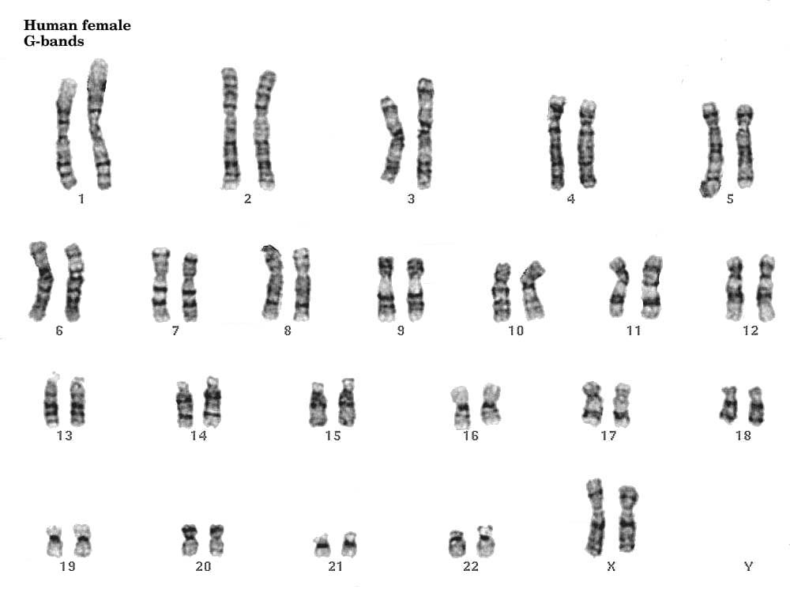
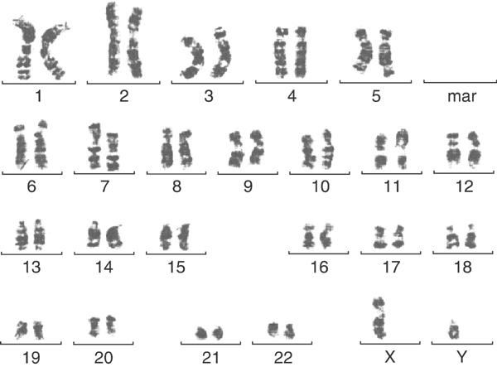
Normal Karyotypes
Female
Male
Strupp C, et al. Leukemia. 2003;17:1200-1202.

Slide 17
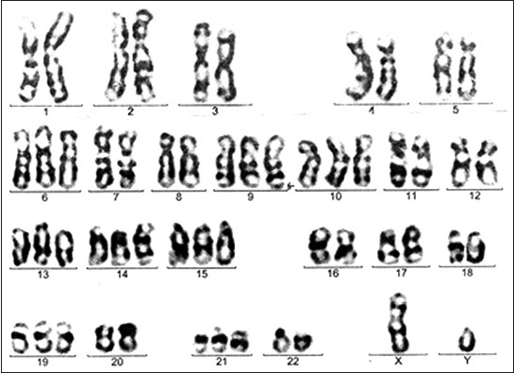
Hyperdiploidy
Belurkar S, et al. Ind J Med Sci. 2013;67:188-192.

Slide 18
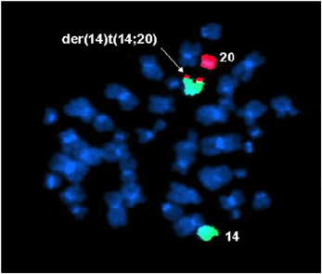
Fluorescence in Situ Hybridization Analysis
t(14;20)
Chromosome
14 stained green
Chromosome
20 stained red
Stralen E, et al. Leukemia. 2009;23:801-803.

Slide 19
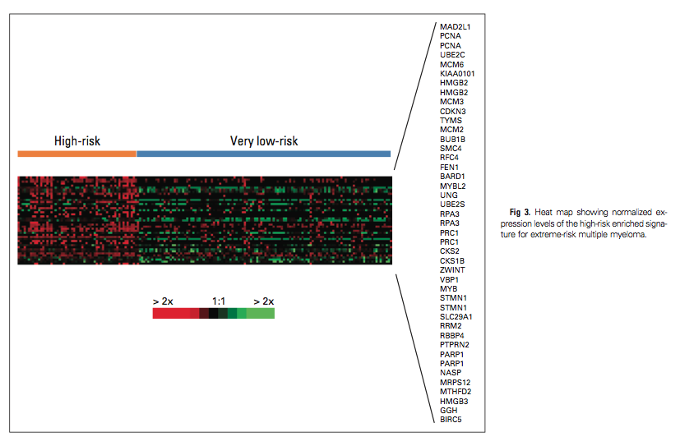
Gene Expression Profiling in Myeloma
Decaux O, et al. J Clin Oncol. 2008;26:4798-4805.
Notes:
Heat map showing normalized expression levels of the high-risk enriched signature for extreme-risk MM

Slide 20
Natural History of Myeloma
Asymptomatic
Symptomatic
100
ACTIVE MYELOMA
2. RELAPSE
REFRACTORY RELAPSE
M-Protein (g/L)
1. RELAPSE
50
MGUS or smoldering myeloma
Plateau remission
20
First-line therapy
Second-line therapy
Third-line therapy
Kuehl WM, et al. Nat Rev Cancer. 2002;2:175-187. Vacca A, et al. Leukemia. 2006;20:193-199. Siegel DS, et al. Community Oncol. 2009;6:12:22-29. Durie BG, et al. Hematol J. 2003;4:379-398; adapted with permission from Durie B.
Notes:
MGUS, monoclonal gammopathy of undetermined significance.

Slide 21
Survival in Myeloma Is Improving With Novel Agents
5-Yr Survival by Age
1.0
Median 7.3 yrs
 | ≤ 65 Yrs | > 65 Yrs
2006-2010 | 73% | 56%
2001-2005 | 63% | 31%
0.9
0.8
0.7
0.6
2006-2010
0.5
Proportion Surviving
0.4
The use of novel agent inductions with melphalan and ASCT have doubled
median survival for nearly all patients
0.3
0.2
2001-2005
0.1
0
0
1
2
3
4
5
6
7
8
9
10
Follow-up From Diagnosis (Yrs)
Kumar SK, et al. ASH 2012. Abstract 3972.
Notes:
ASCT, autologous stem cell transplantation.

Slide 22
Treatment of Multiple Myeloma
Confirmed Diagnosis of Multiple Myeloma: CRAB Criteria
Determination of transplant eligibility
Immediate interventions for serious adverse events
Individualized Treatment Selection for Induction Therapy
Transplant Eligible
Works rapidly (CR, nCR, VGPR)
Well tolerated
Spares stem cells
Level of evidence: 1 or 2A
Transplant Ineligible
Achieving a CR or nCR
Level of evidence: 1 or 2A
Tolerability and QoL
PS and comorbidities
Continued Treatment
Salvage therapy Maintenance therapy
NCCN. Clinical practice guidelines in oncology: multiple myeloma. v.2.2014.
Notes:
CRAB, calcium elevation, renal insufficiency, anemia, bone disease; CR, complete response; nCR, near complete response; PS, performance score; QoL, quality of life; VGPR, very good partial response.

Slide 23
Clinical Considerations in Deciding Induction Therapy
High tumor burden
  Pulse dexamethasone
  Combination therapies with alkylators and IMiDS and bortezomib
Renal failure
  Pulse dexamethasone
  Combination therapies with alkylators and thalidomide and bortezomib (role of lenalidomide uncertain)
Hypercalcemia
  Pulse dexamethasone
  Bisphosphonates
Frail
  Avoid high-dose dexamethasone
Clotting or bleeding history
  Assess risk of use of lenalidomide/ thalidomide and anticoagulation
Preexisting neuropathy
  Assess use of bortezomib/ thalidomide
Cytogenetic abnormalities
  Indication for bortezomib/ lenalidomide
Niesvizky R, et al. Oncology (Williston Park). 2010;24:14-21. NCCN. Clinical practice guidelines in oncology: multiple myeloma. v.2.2014. Stadtmauer EA. Oncology (Williston Park). 2010;24:7-13.
Notes:
IMiD, immunomodulatory drug.

Slide 24
NCCN Recommendations for Adjunctive Treatment
Bone disease
  Bisphosphonates (category 1)
  Radiation therapy
  Orthopedic consultation
  Vertebroplasty or kyphoplasty
Hypercalcemia
  Hydration, steroids, furosemide
  Zoledronic acid preferred
Hyperviscosity
  Plasmapheresis
Anemia
  Consider erythropoietin
Infection
  IVIG for recurrent infections
  Pneumovax and influenza vaccine
  PCP, herpes and antifungal prophylaxis for high-dose or
  long-term steroids
  Herpes zoster prophylaxis with bortezomib
Renal dysfunction
  Avoid aggravating factors: contrast, NSAIDs, dehydration
  Not a contraindication to HCT
  Monitor bisphosphonates closely
Coagulation/thrombosis
  Prophylactic anticoagulation with IMiDs
NCCN. Clinical practice guidelines in oncology: multiple
myeloma. v.2.2014. Miceli T, et al. Clin J Oncol Nurs. 2011;15(suppl):
9-23. Faiman B, et al. Clin J Oncol Nurs. 2011;15(suppl):66-76.
Notes:
HCT, hematopoietic cell transplantation; IMiD, immunomodulatory drug; IVIG, intravenous immunoglobulin; NSAID, nonsteroidal antiinflammatory drug; PCP, Pneumocystis pneumonia.

Slide 25
Go Online for More CCO
Coverage of Multiple Myeloma!
Capsule Summaries of all the key data
Additional CME-certified slideset with expert faculty commentary on all the key studies
clinicaloptions.com/oncology

